Slide 1

Computational Physics
Lesson 3 – Monte Carlo Methods

Slide 2
Learning Objectives
Appreciates that there are a variety of techniques in computational modelling.
Understands basic applications of monte-carlo methods
Implements simple monte-carlo methods

Slide 3
Key Idea
Use randomness and repeated sampling.
(this might be easier if the problem is very complicated)

Slide 4
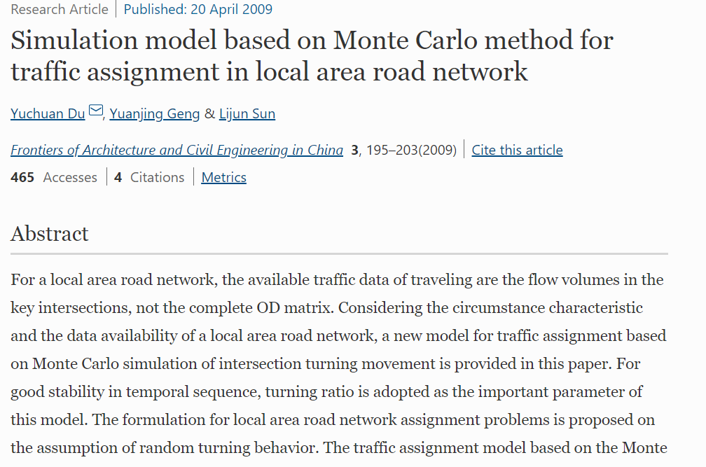

Slide 5
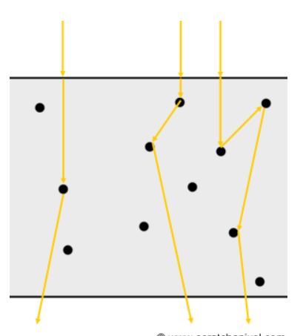

Slide 6

Example – Calculating $π$

Slide 7
Further Reading
https://www.scratchapixel.com/lessons/mathematics-physics-for-computer-graphics/monte-carlo-methods-in-practice/monte-carlo-methods
https://pbpython.com/monte-carlo.html
https://towardsdatascience.com/understanding-monte-carlo-simulation-eceb4c9cad4
https://machinelearningmastery.com/monte-carlo-sampling-for-probability/

